Slide 1
Happy New year

Slide 2
EMAIL

Slide 3
Ways to access email
Web Browser – Edge, Firefox, Chrome, Safari, Opera. Best browsers: https://www.toptenreviews.com/best-internet-browser-software
Email client – Software installed on your device – Thunderbird, eM Client, Claws Mail
Proprietary software – Windows 10 Mail app, MS Office Outlook PC or Mac
Mobile apps – iOS or Android

Slide 4
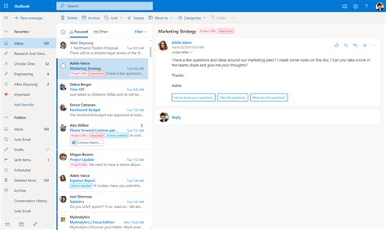
What is different – browser vs client?
Accessing your email with a browser uses webmail. No backup, arguably fewer features.
Email clients access email using POP, IMAP and SMTP. You have a backup on your device so you can access your email offline. IMAP is recommended.
Proprietary software, special software involved to access mail and provide other functions. MSN, Mobile apps, Windows 10 mail app.
Most standard email accounts can access your email via the Internet (webmail) or through an email client or your mobile app. Chose the one you like based on your preferences.

Slide 5
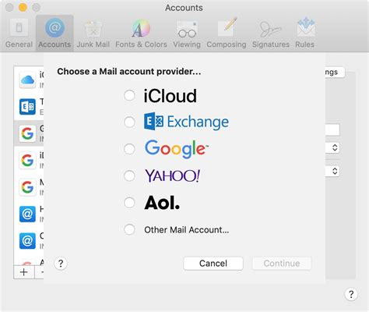
Email accounts
Many are free, paid also available.
You get email addresses through your Internet Service Provider – downside is that if you change providers you lose the account.
Free – Microsoft (outlook.com, hotmail), Yahoo, Google (gmail), Proton (encrypted), iCloud (Apple), Aol, Zoho.
Different providers provide inboxes of different sizes.
Some only provide webmail access – Proton Mail.

Slide 6
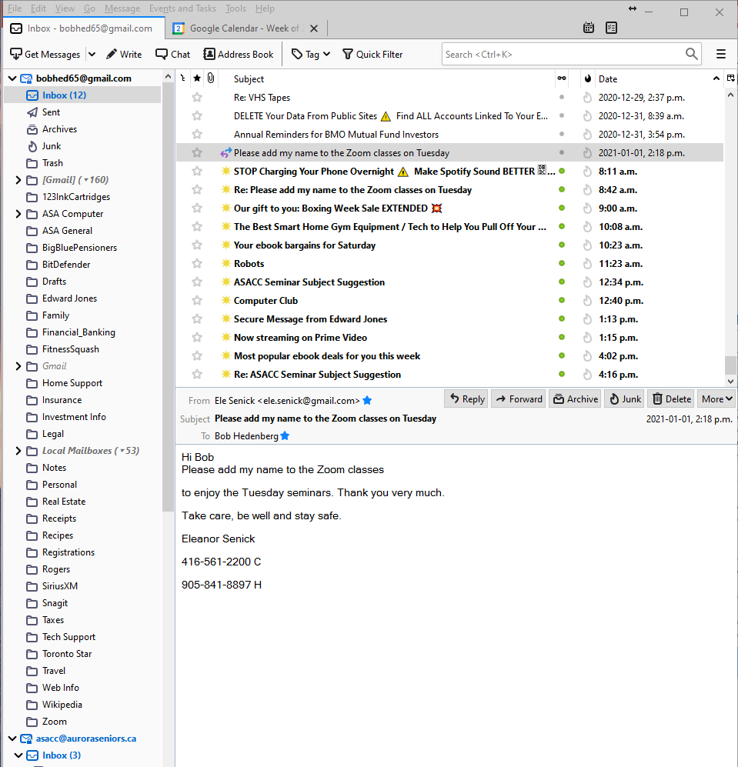
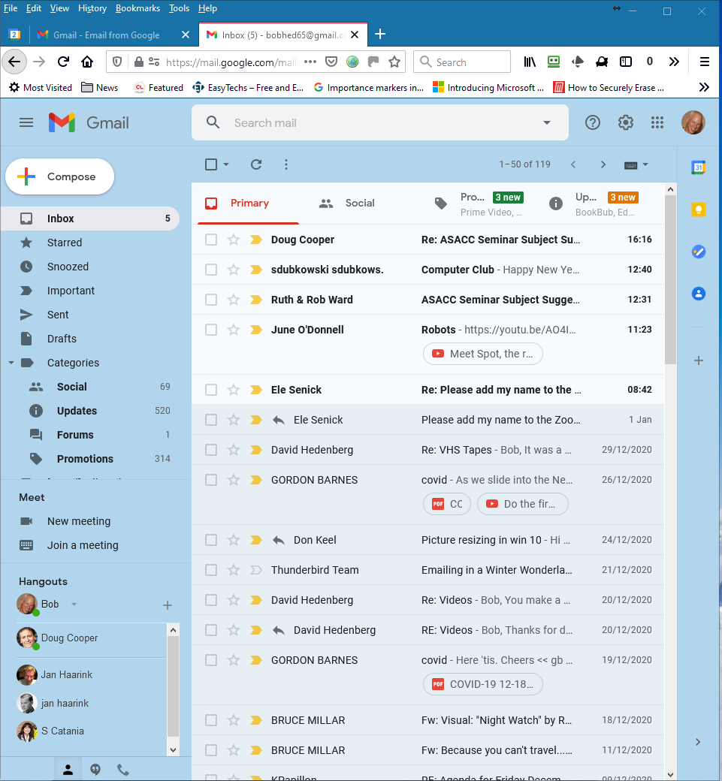
Browser vs Client
Email Client
Same email in a Browser

Slide 7
Configure/manage your email account
Adding an email account, new or to an email client.
Changing the layout and look of your email.
Changing the options and settings.
Block or filter email addresses by sender, subject, content.
Change font, language, spellcheck.
Calendar and chat integration.
Security and privacy settings.
Forward your email from one account to another.
The details vary from one provider to another and details vary between email clients but the concepts are similar. Comprehensive online help is available.

Slide 8
Reviewing the alternatives
Gmail using a browser, two different clients (Thunderbird & Outlook and the Windows 10 Mail app.
A Microsoft email account using the same options to access the email.
Some of the basic settings for each option including adding an existing email account to the Windows 10 mail app or Thunderbird or Outlook.
The term “Outlook” can be easily confused. There are the legacy (older) versions of the paid Outlook program and the new one included with Office 365. It can also be a reference to Outlook.com, Microsoft’s browser access to your email.
All of these can access email from competitive providers. You can access your gmail with any of the tools and access your Microsoft or other email through gmail.
Mobile apps – iOS or Android.

Slide 9
Additional information
Thunderbird, a free and well supported email client with professional features and options. Download - https://www.thunderbird.net/en-US/download/ User basic information - https://support.mozilla.org/en-US/products/thunderbird/learn-basics-get-started
Microsoft Outlook, paid but very well supported with many features and options. To buy Outlook standalone for $139 Cdn - https://www.microsoft.com/en-ca/microsoft-365/p/outlook/cfq7ttc0k7c4/?activetab=pivot%3aoverviewtab
Same website for Office 365 which includes all MS office products. Price varies depending on monthly, annual and number of users. Lots of help and tutorials for all Microsoft products - https://support.microsoft.com/

Slide 10
Questions?
Email can be as simple as you want it to be. But also very powerful and useful if you want to know more and take advantage of the many options available. Help is available via email or Q&A sessions. Sending your questions in advance helps us prepare an answer if we are not familiar with your email provider or the way you use email.

